Slide 1
QGIS Tutorial
Kyle Cheung, Graduate Student
2019/07/16
Digital Agriculture Lab, UC Davis
kyhcheung@ucdavis.edu
https://github.com/kylezoa/gis-tutorial

Slide 2
Tutorial Goals
Identify path/row for Landsat 8 images using Earth Explorer
Obtain public GIS files
Clip one shapefile with another shapefile
Change symbology or the appearance of a file
Perform raster calculation within a defined area
Calculate statistics of a defined area within a raster
*Download Landsat 8 images from Landsat on AWS

Slide 3
Before Tutorial
Download and Install QGIS 3.4.9 LTR:
http://qgis.org/downloads/QGIS-OSGeo4W-3.4.9-1-Setup-x86_64.exe
Download Landsat 8 Level-2 Product Images:
https://ucdavis.box.com/s/1kwojur5m1tok1fj7uiep2ozcgl9qr2u
Register for Earth Explorer account:
https://earthexplorer.usgs.gov
Download LandIQ Land Use data:
ftp://ftp.wildlife.ca.gov/BDB/GIS/BIOS/Public_Datasets/2600_2699/ds2677.zip
Download Region of Interest .kml file:
https://ucdavis.box.com/s/xqbzkbm8xythr0hg063iiee519bhhuas

Slide 4

QGIS

Slide 5
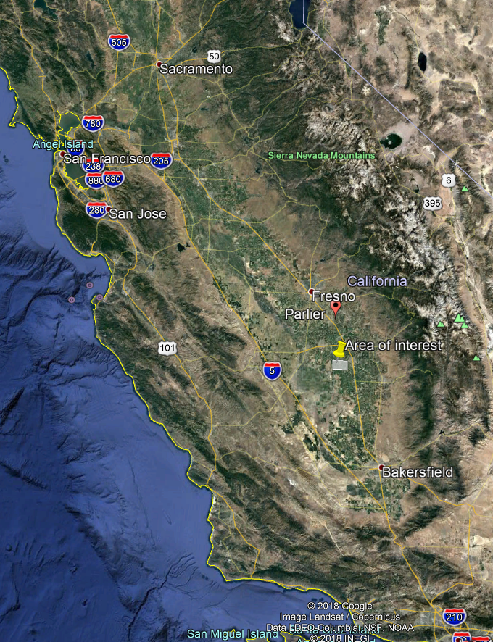
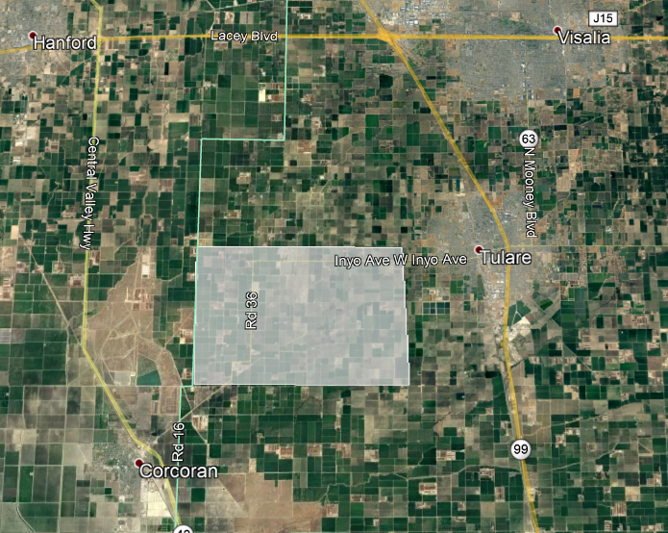
Area of Interest

Slide 6
Data Resources
Brazil: https://github.com/juliohm/awesome-brazil-data
India: https://data.gov.in/
Thailand: https://github.com/pnphannisa/awesome-thai-gis
United States: https://uhcl.libguides.com/gis-data/GIS/data/us
European Space Agency (Sentinel): https://scihub.copernicus.eu/
US Geological Survey (Landsat): https://earthexplorer.usgs.gov

Slide 7
Types of Data in GIS
Vector
Lines, coordinates, angles, polygons, vectors
Often used to draw boundaries
Geometrically based
Raster
Gridded data
Each grid points has a value
Images are raster data (hard to stretch it out or rotate it)
Often used to describe elevation, surface reflectance

Slide 8
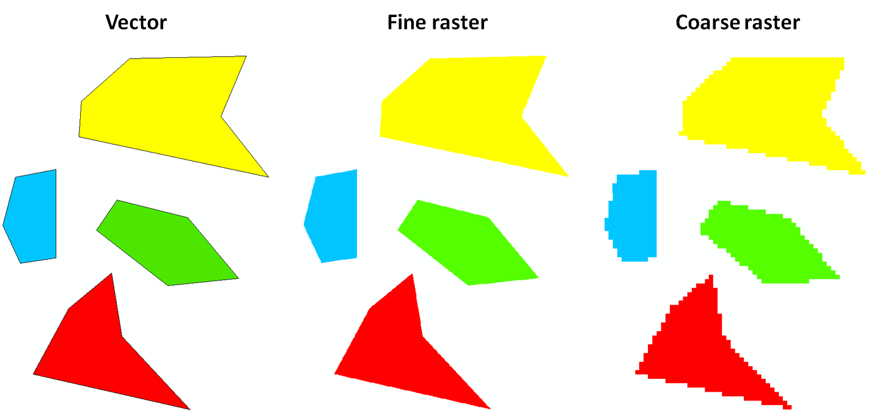
Types of Data in GIS
https://gis.stackexchange.com/questions/57142/what-is-the-difference-between-vector-and-raster-data-models

Slide 9
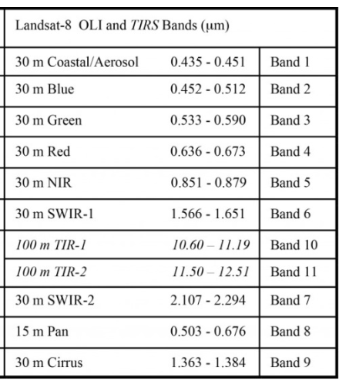
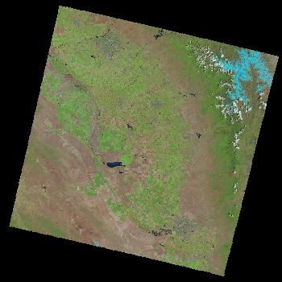
Data Used
Landsat 8 Level 2 Surface Reflectance from Operational Land Imager (OLI)
Each file contains a spectral band
We will use Band 4 and Band 5 today
Raster image

Slide 10
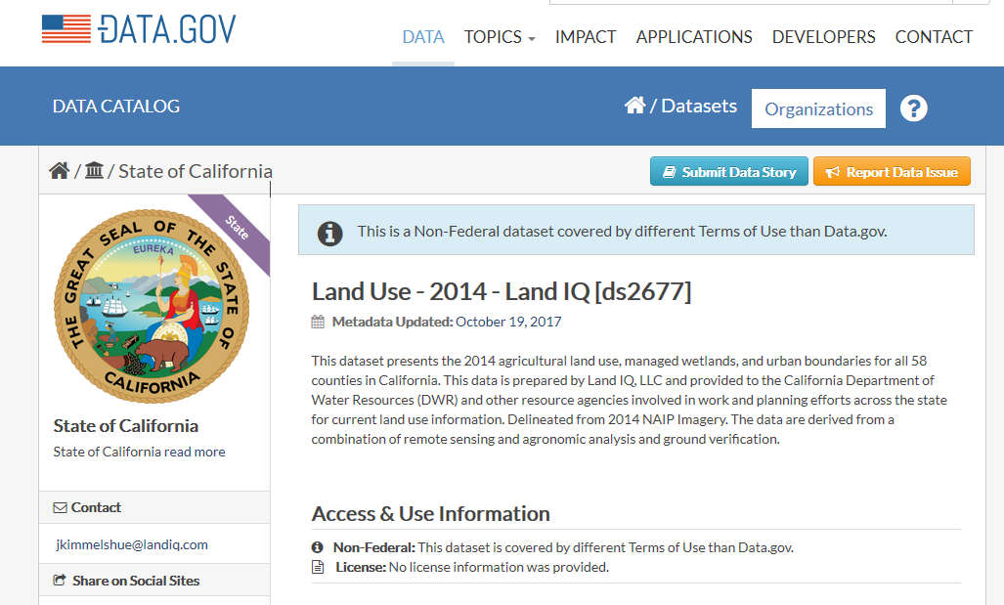
Data Used
LandIQ Land Use Data
Description of agricultural land use
What is being grown on this field?
Vector, shapefile

Slide 11
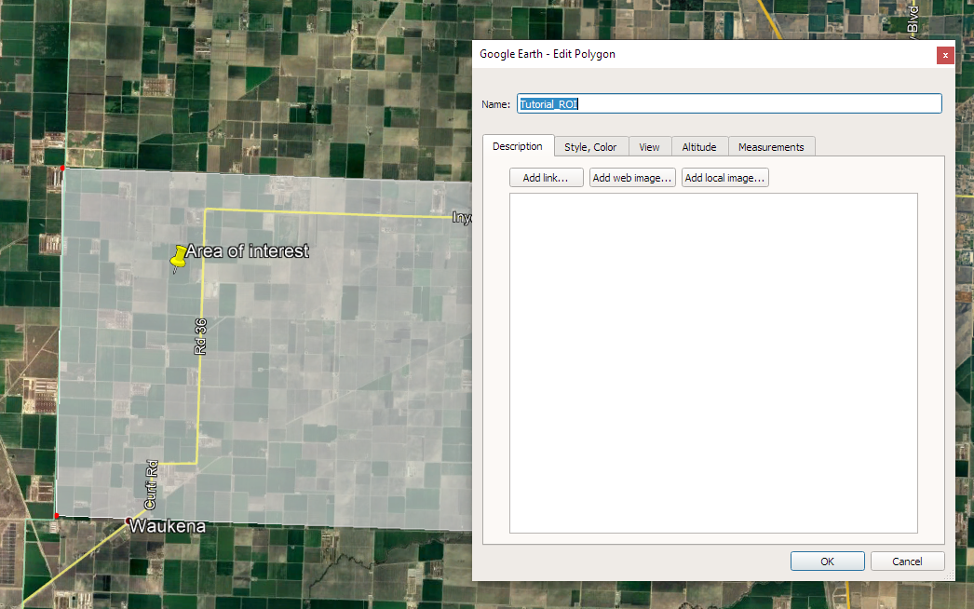
Data Used
Region of Interest File (.kml, .kmz)
A polygon drawn in Google Earth to denote an area of interest

Slide 12
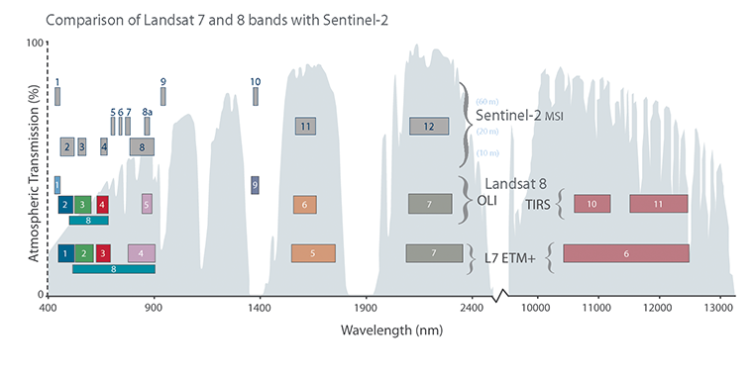
Satellite Imagery
Landsat 8
Description
https://www.usgs.gov/land-resources/nli/landsat/landsat-science-products
Data Access
https://earthexplorer.usgs.gov
Sentinel-2
Description
https://earth.esa.int/web/sentinel/user-guides/sentinel-2-msi/resolutions/spatial
Data Access
https://scihub.copernicus.eu/
https://www.usgs.gov/centers/eros/science/usgs-eros-archive-sentinel-2-comparison-sentinel-2-and-landsat?qt-science_center_objects=0#qt-science_center_objects

Slide 13
Satellite Imagery
Identify path/row number for Landsat 8 images using Earth Explorer from USGS
https://earthexplorer.usgs.gov
A path and row number describe a scene

Slide 14
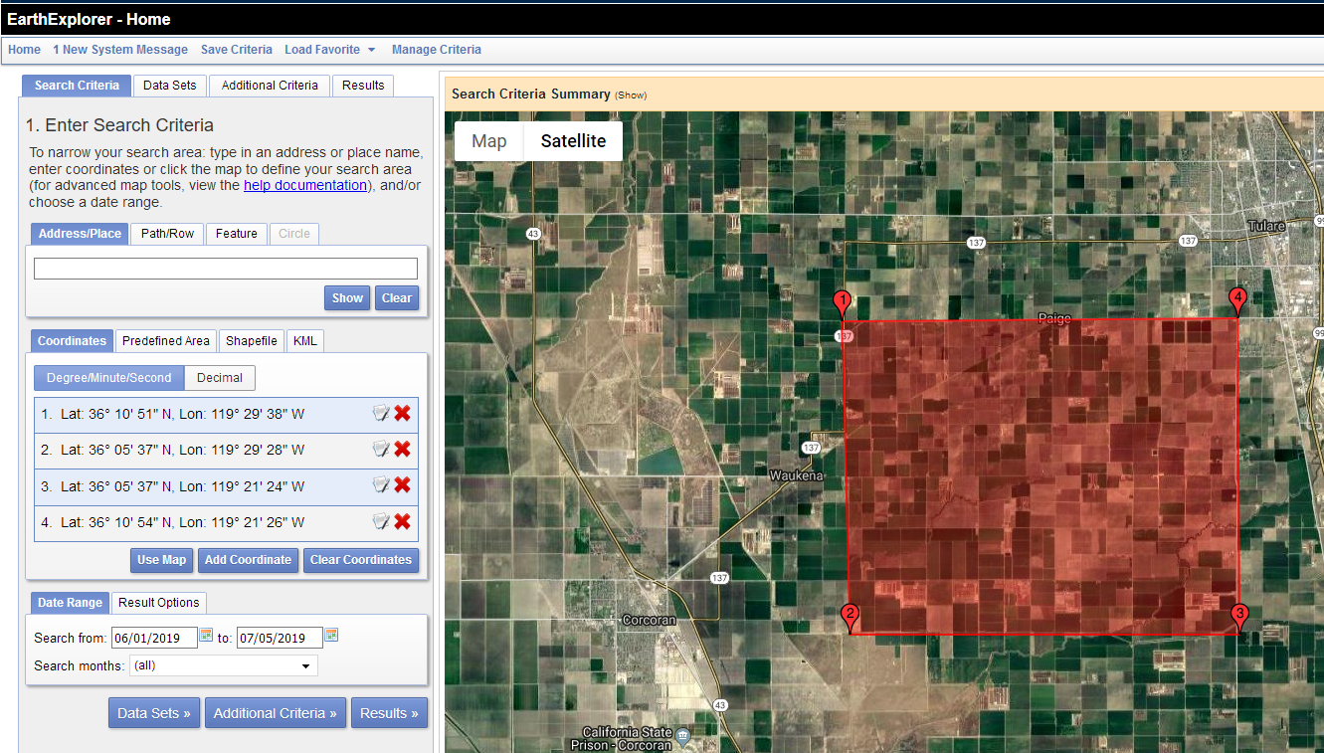
https://earthexplorer.usgs.gov

Slide 15
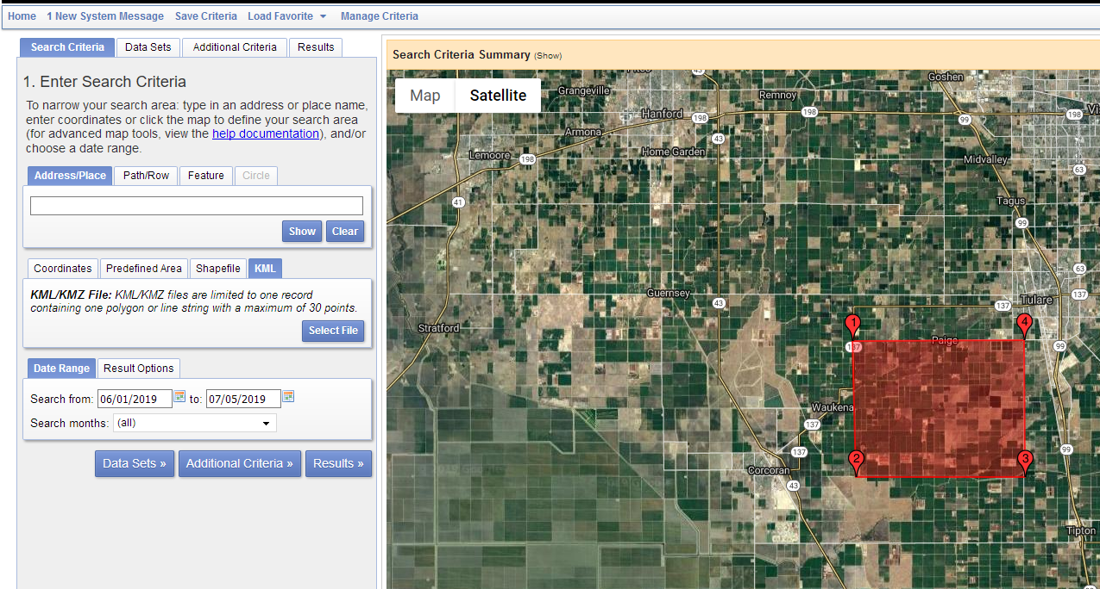
https://earthexplorer.usgs.gov

Slide 16
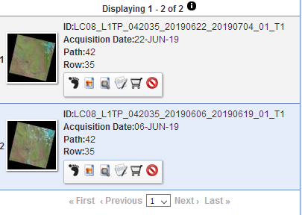
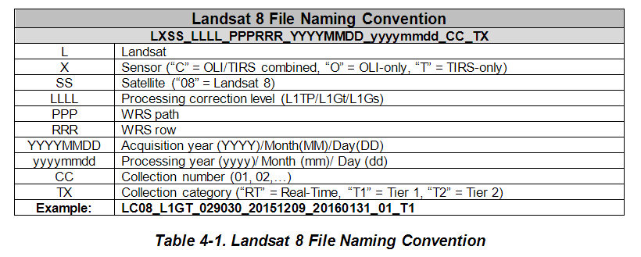
Satellite Imagery
ID: LC08_L1TP_042035_20190622_20190704_01_T1
https://prd-wret.s3-us-west-2.amazonaws.com/assets/palladium/production/atoms/files/LSDS-1574_L8_Data_Users_Handbook_v4.0.pdf

Slide 17
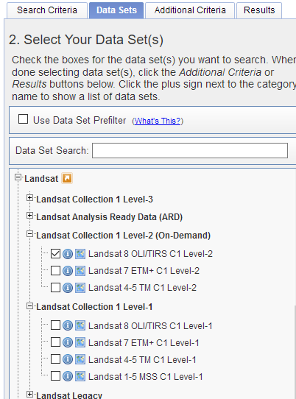
Satellite Imagery
Level-1 Images are not corrected for atmospheric disturbances (haze, ozone)!
Use Level-2 images that contain surface reflectance values
We will use the files that I have uploaded to Box.

Slide 18
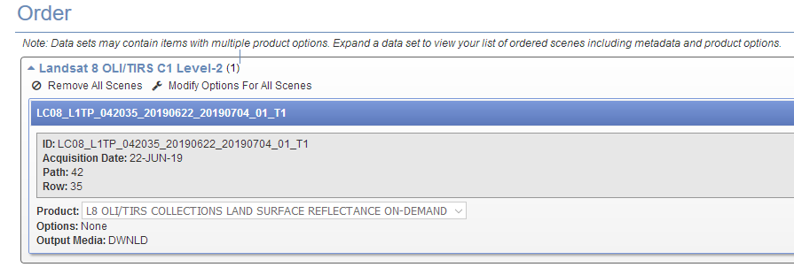
Satellite Imagery

Slide 19
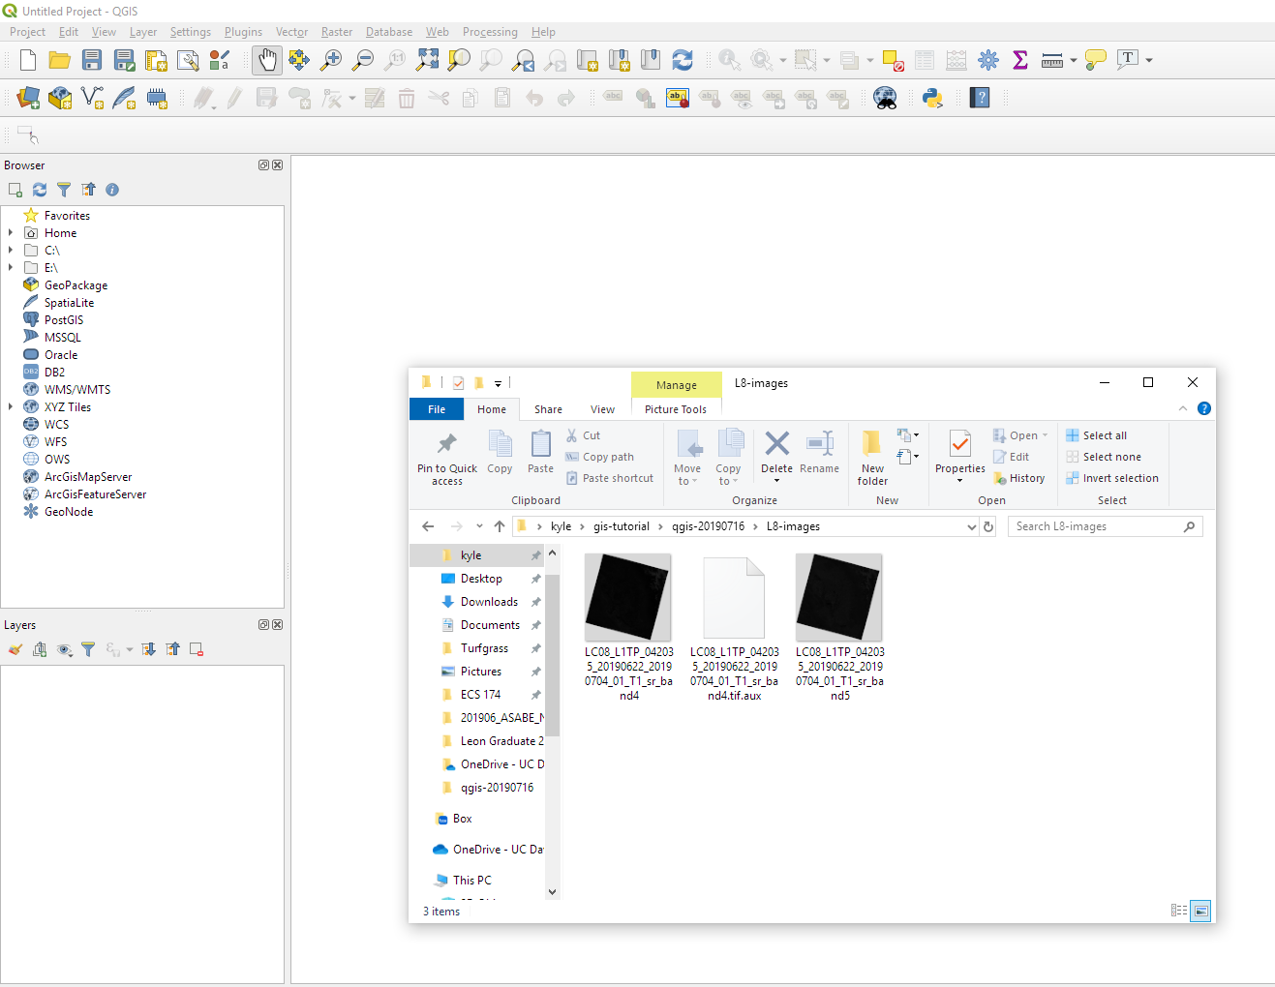
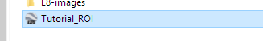

Import Data

Slide 20
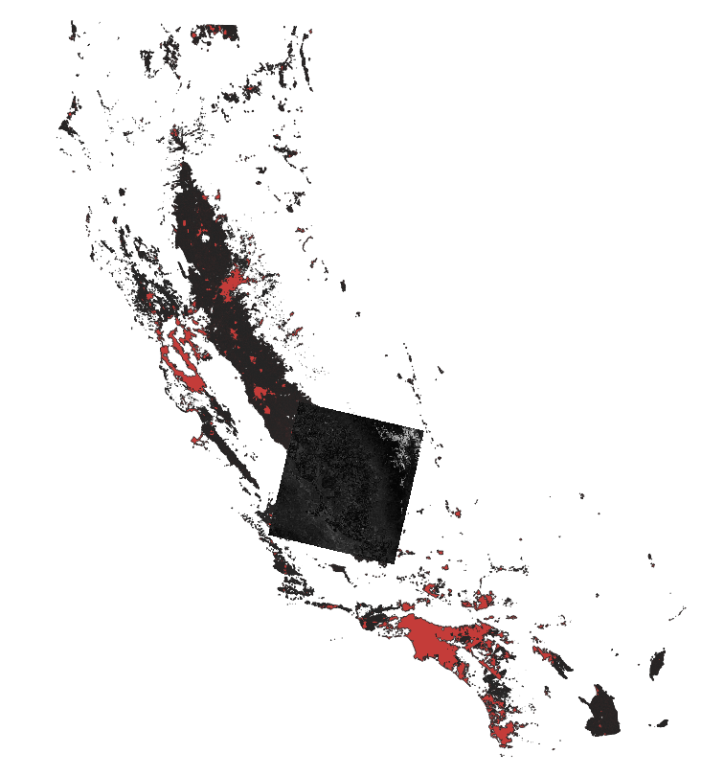
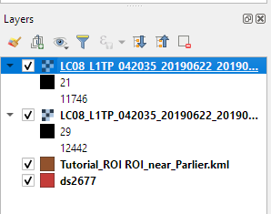
Import Data

Slide 21
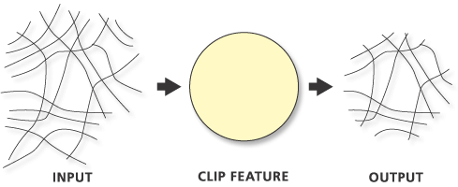
Clipping Shapefiles
https://pro.arcgis.com/en/pro-app/tool-reference/analysis/clip.htm

Slide 22
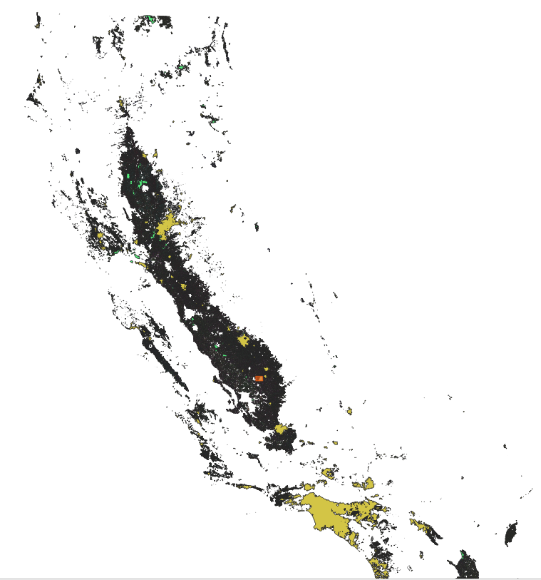
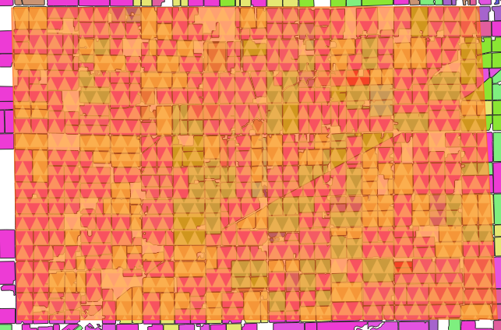
Clipping Shapefiles

Slide 23
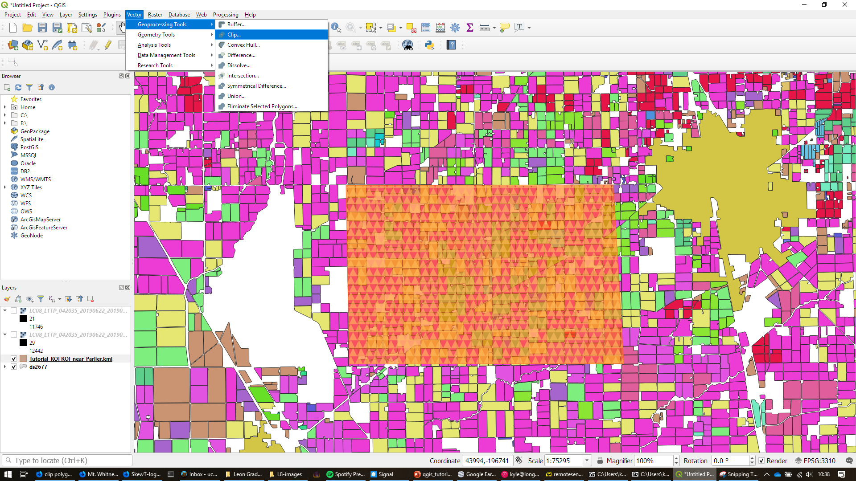
Clipping Shapefiles

Slide 24
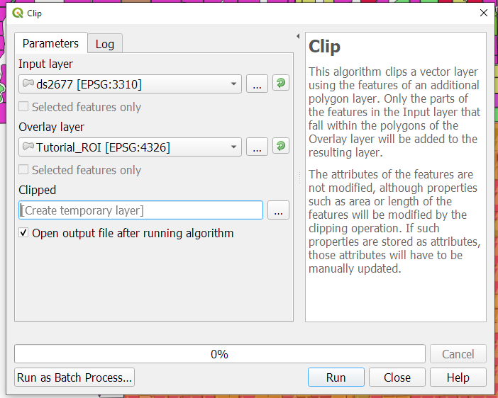
Clipping Shapefiles

Slide 25
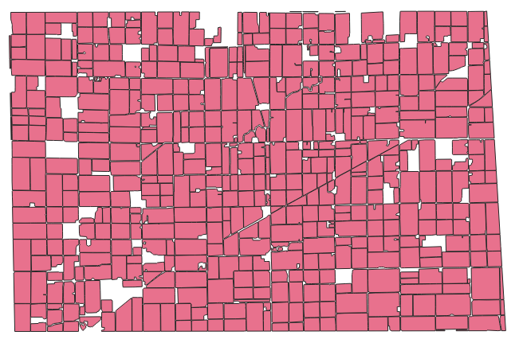
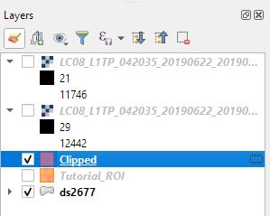
Clipping Shapefiles

Slide 26
Change Symbology
Using color and symbols to show trends and label data

Slide 27
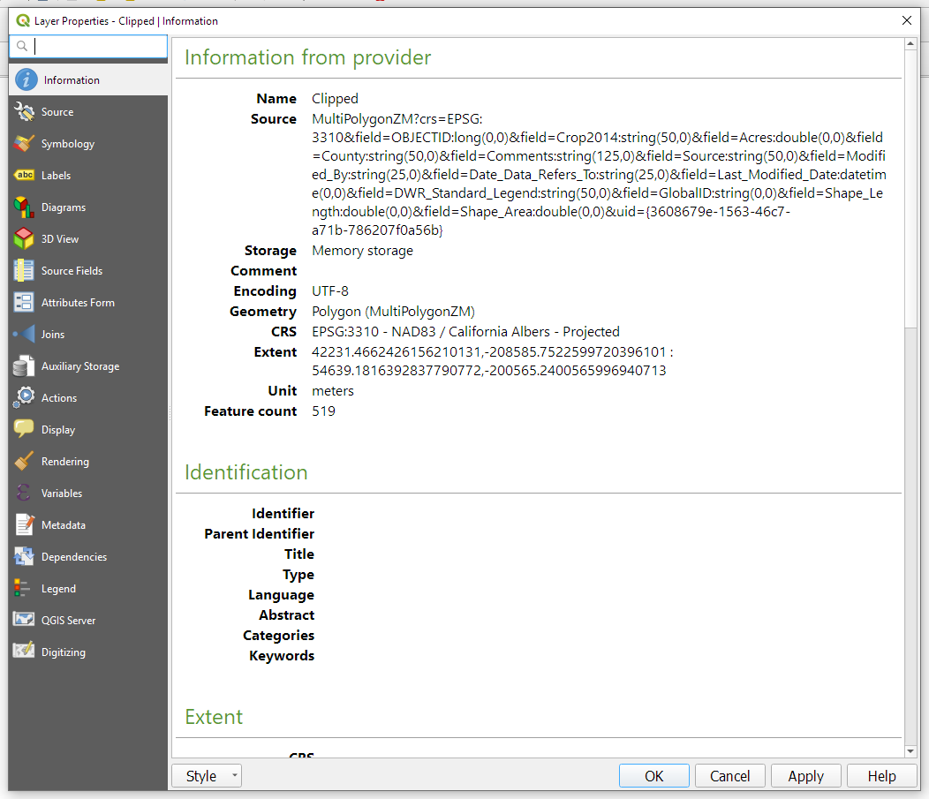

Slide 28
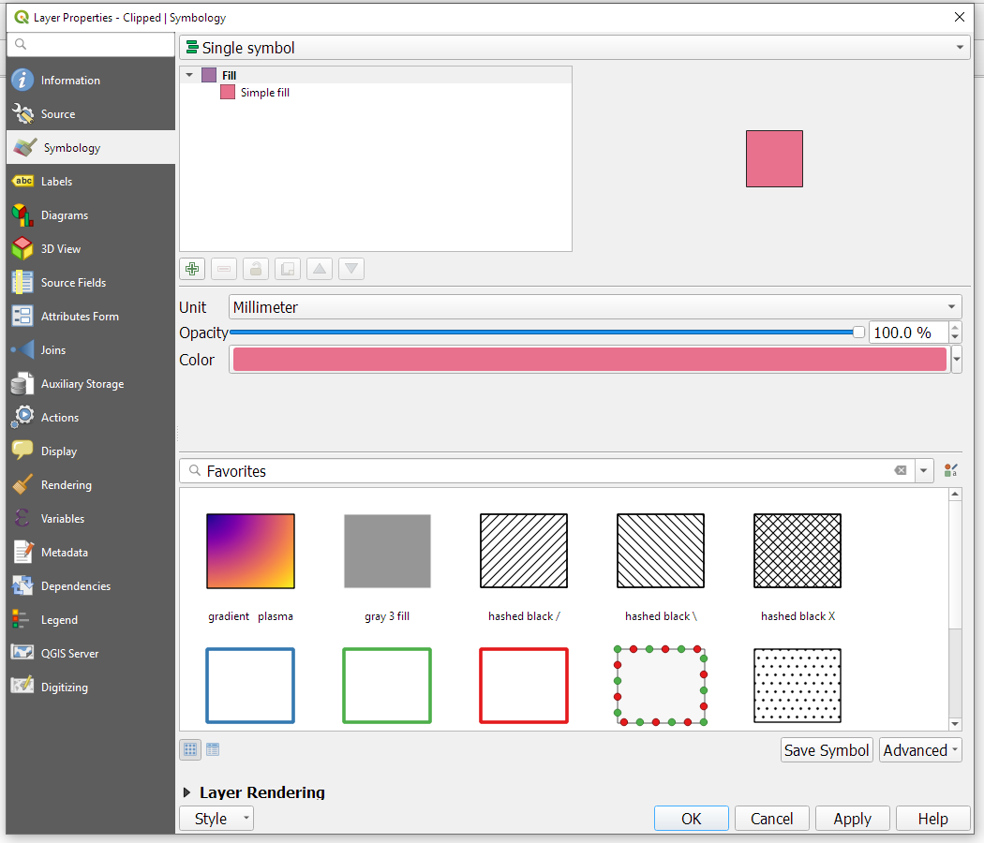

Slide 29
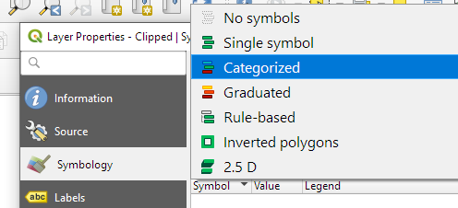
Change Symbology

Slide 30
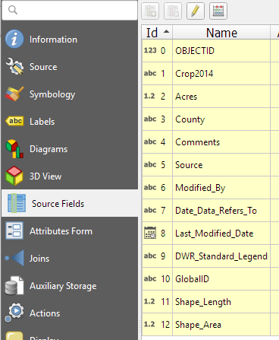
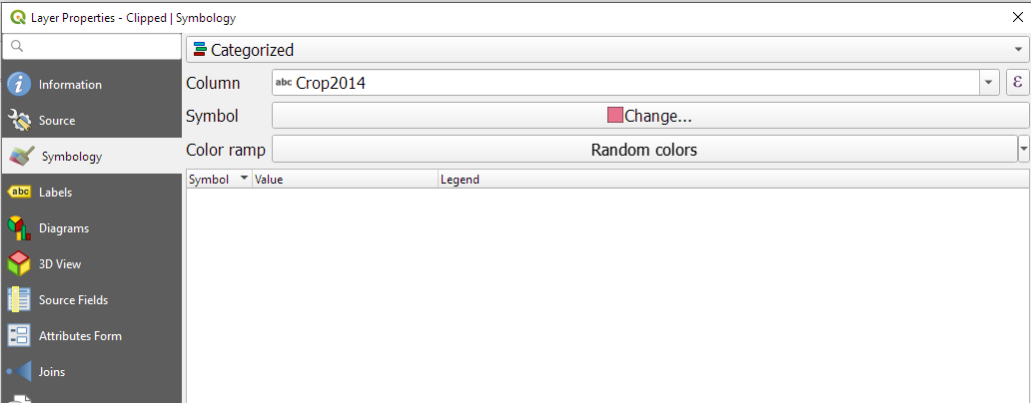
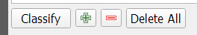
Change Symbology
1. Select a category
2. Click Classify to show all categories in the selected data column

Slide 31
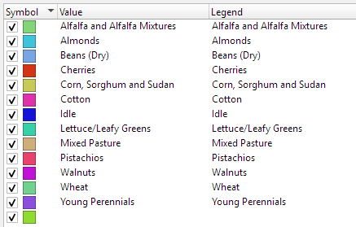
Change Symbology

Slide 32
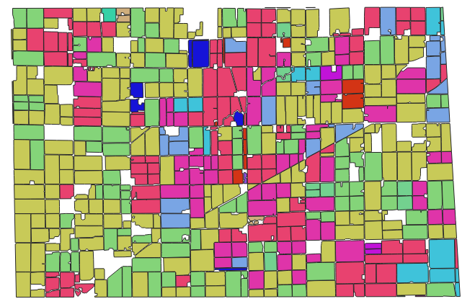
Change Symbology

Slide 33
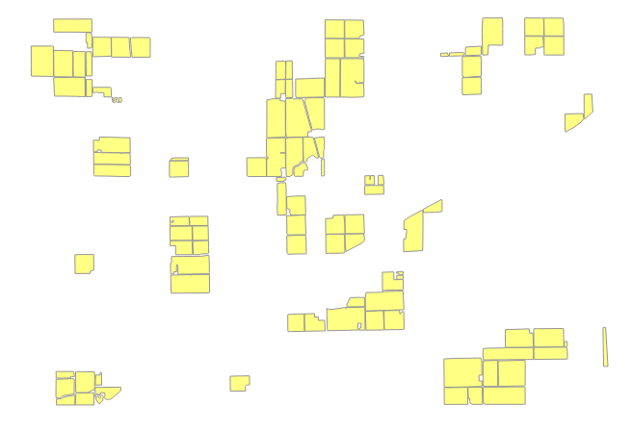
Isolate a Feature Type
Each polygon is a “feature” in the shapefile.

Slide 34
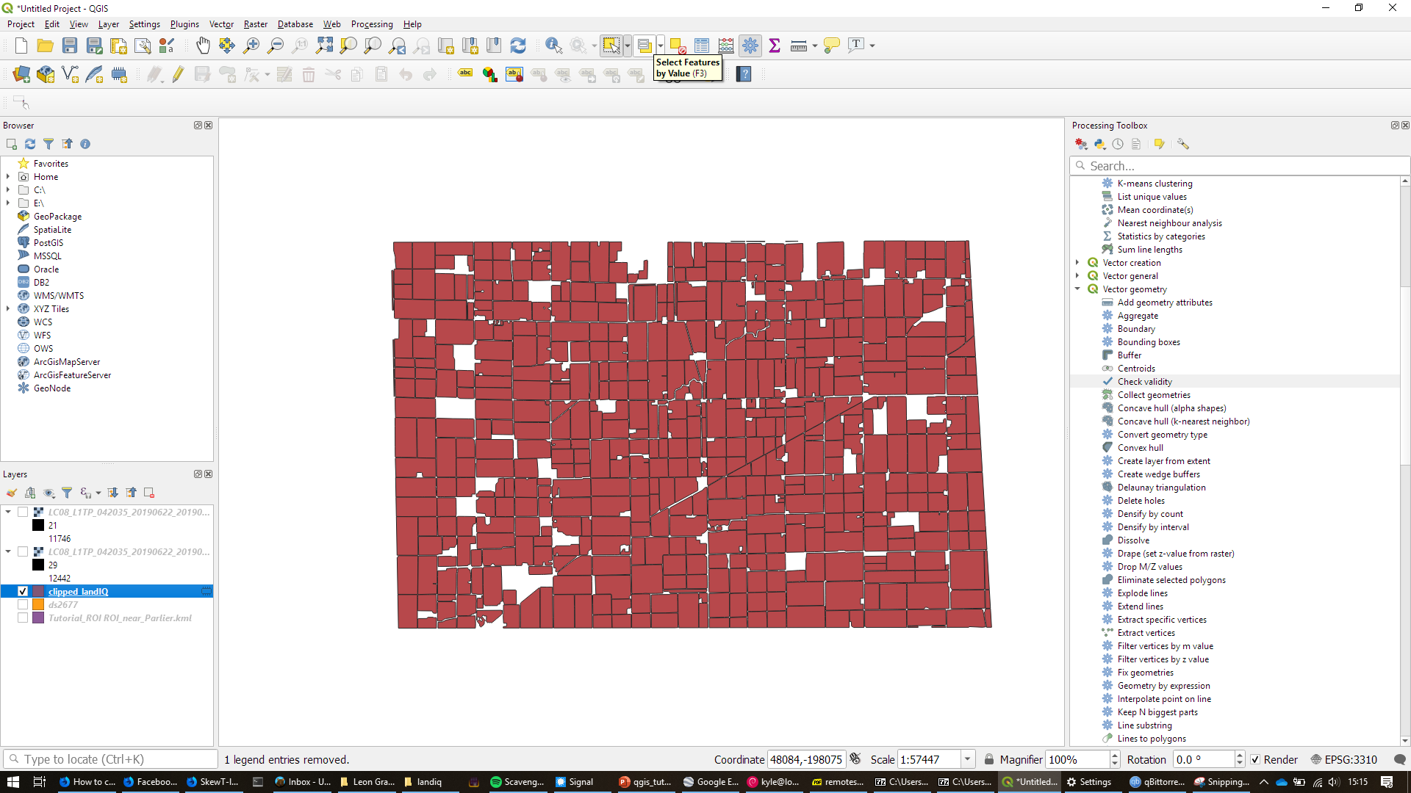
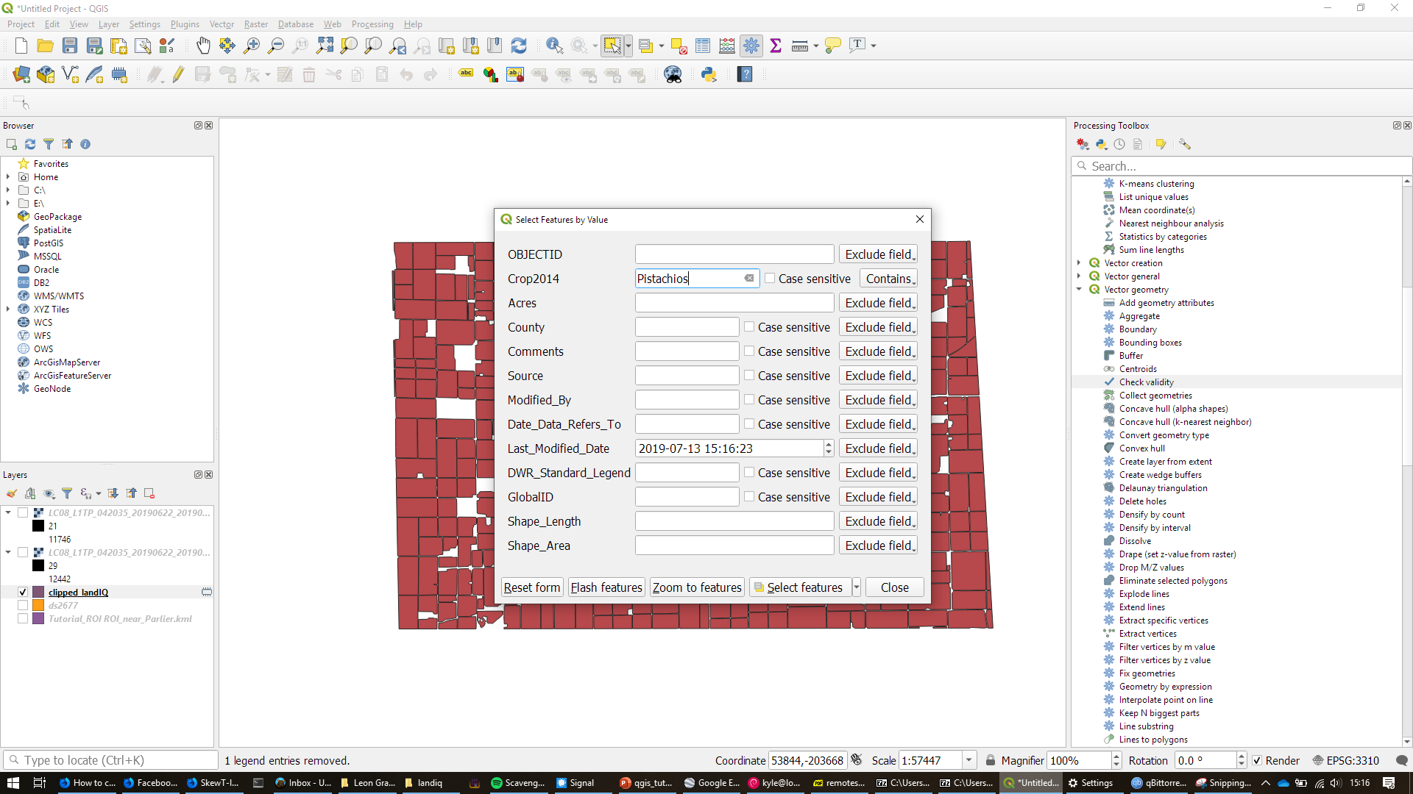
Isolate a Feature Type

Slide 35
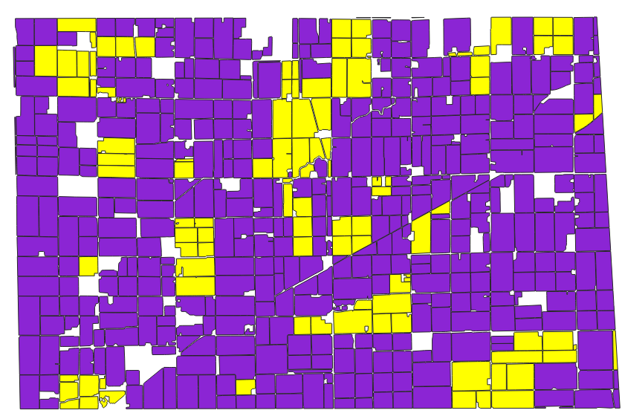
Isolate a Feature Type

Slide 36
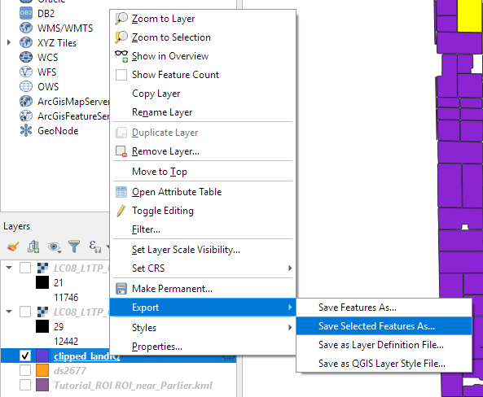
Isolate a Feature Type

Slide 37
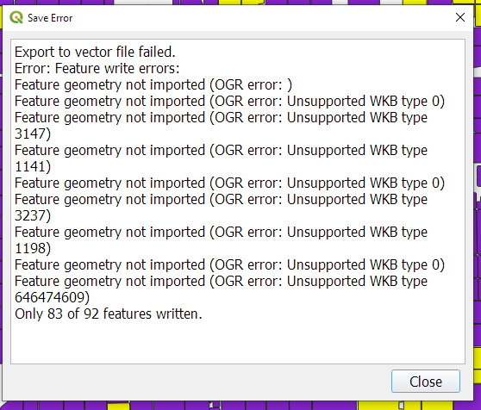

Isolate a Feature Type

Slide 38
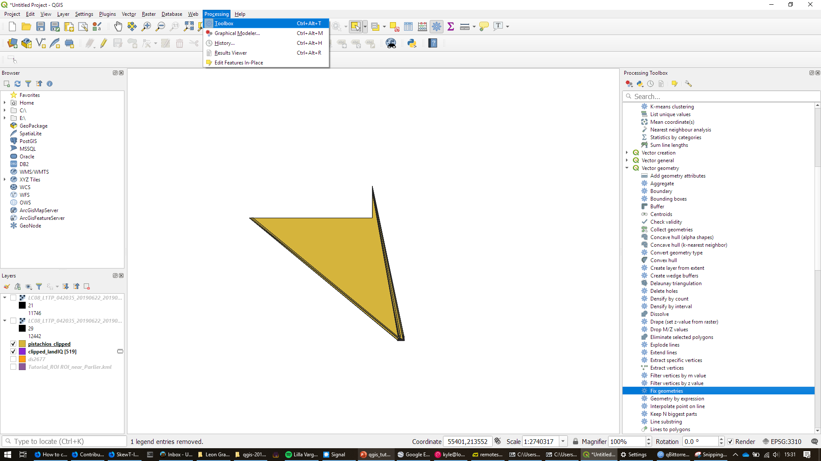
Isolate a Feature Type
Click on Fix geometries.

Slide 39
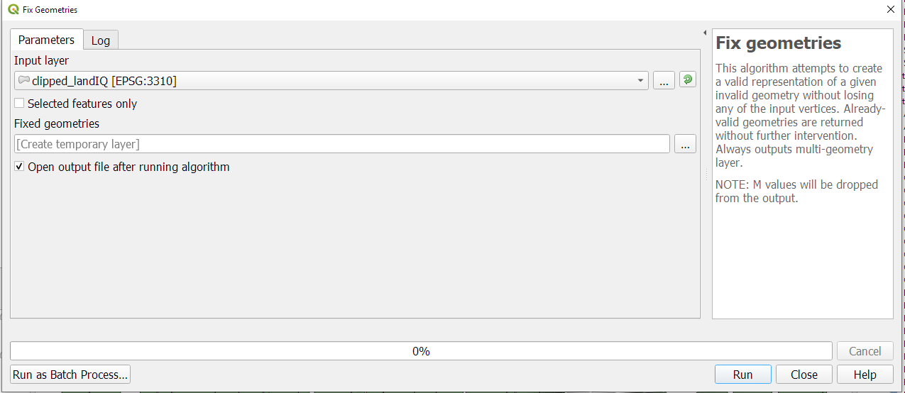
Isolate a Feature Type

Slide 40
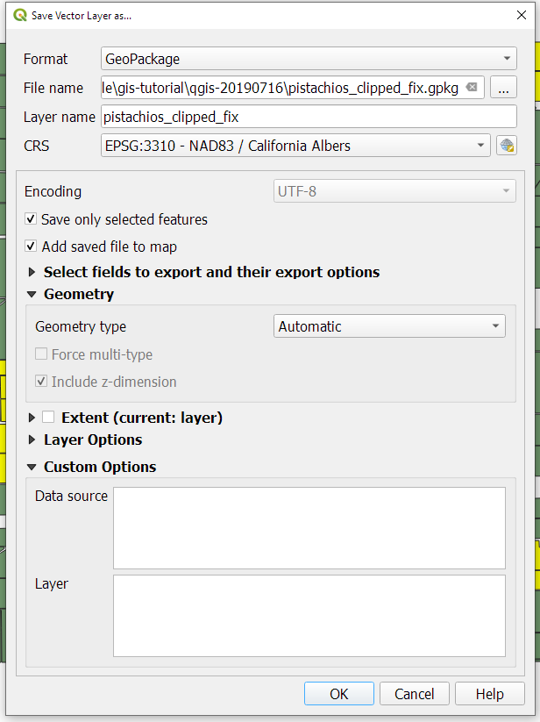
Isolate a Feature Type

Slide 41
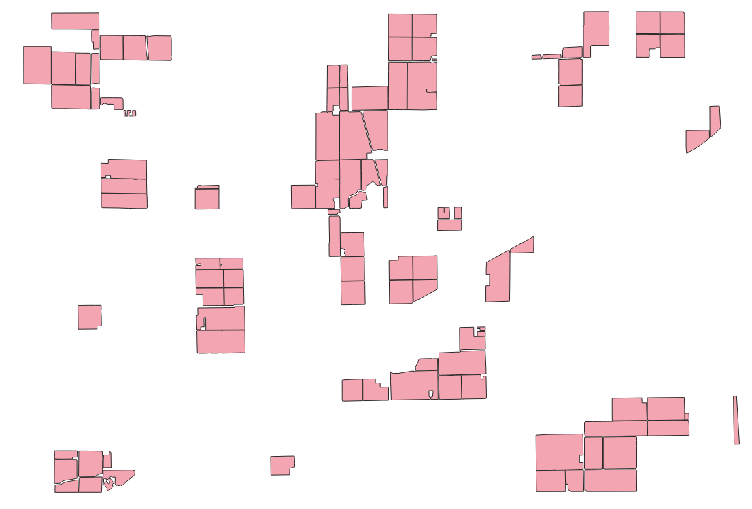
Isolate a Feature Type

Slide 42
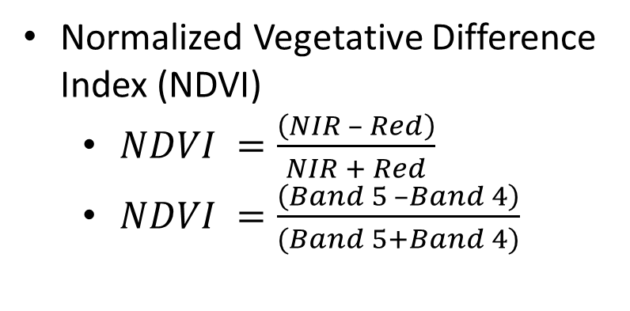
Calculate NDVI
Normalized Vegetative Difference Index (NDVI)
$NDVI =\frac{\left(NIR – Red\right)}{NIR + Red}$
$NDVI =\frac{\left(Band 5 –Band 4\right)}{(Band 5+Band 4)}$

Slide 43
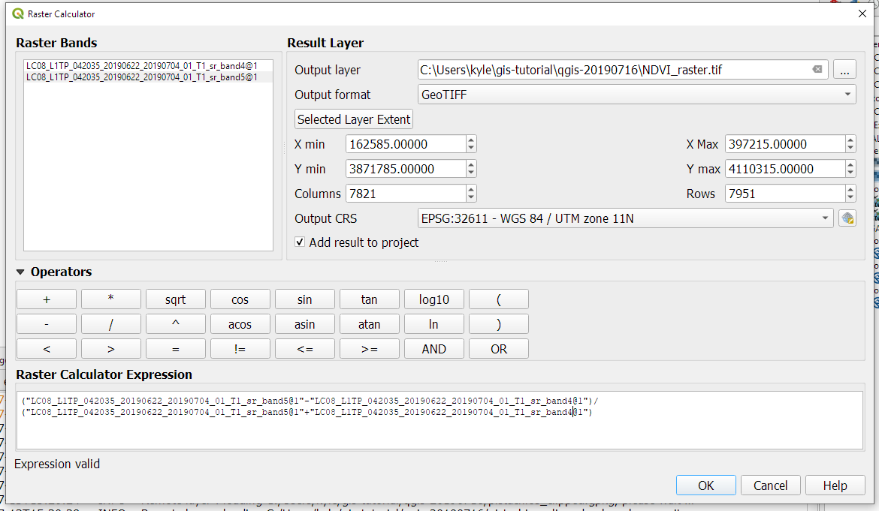
Calculate NDVI

Slide 44
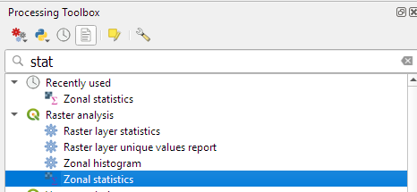
Calculate NDVI

Slide 45
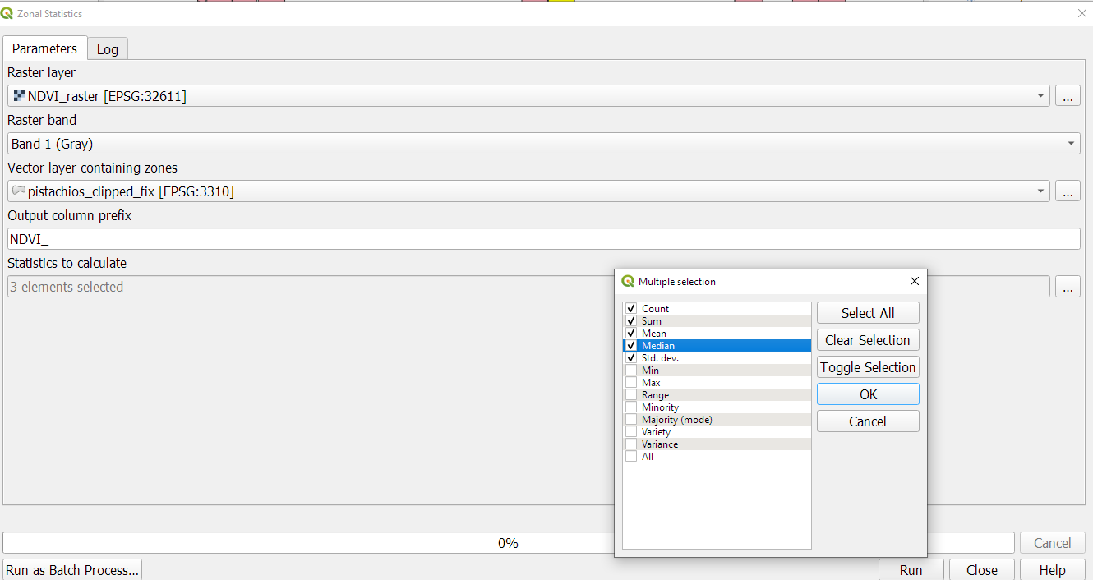
NDVI Statistics

Slide 46
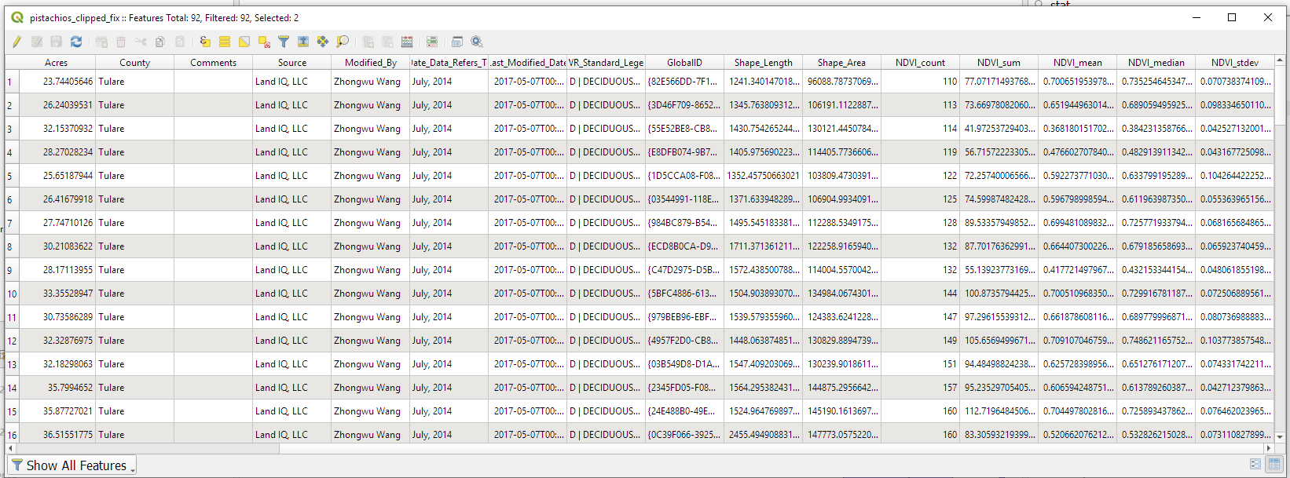
NDVI Statistics

Slide 47
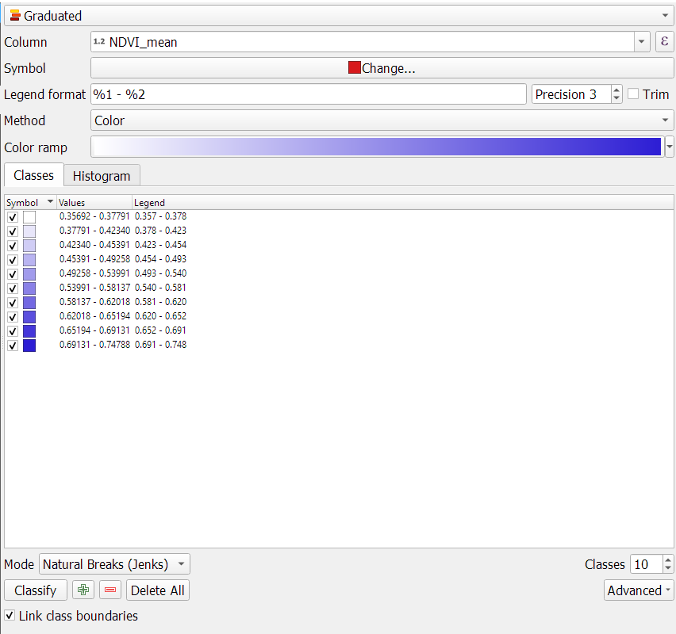
Display NDVI Statistics

